Slide 1





PSBs Hackathon Series 2026
(An Initiative of Government of India, Ministry of Finance , Department of Financial Services)
PRESENTS

Slide 2

PROBLEM STATEMENT & TEAM DETAILS
TEAM NAME (AS SUBMITTED ON PORTAL) |  | GenZPT
PROBLEM STATEMENT TITLE |  | AI Driven Early Warning System for Internal & Privileged User Fraud
 | NAME | GENDER | AREA OF EXPERTISE
Member 1 | Abhaykumar Roy | Male | Backend Developer
Member 2 | Dhiraj Agrawal | Male | AiML
Member 3 | Aditya Thakare | Male | Frontend Developer
Member 4 | Sanyam Patwari | Male | Banking & Security

Slide 3



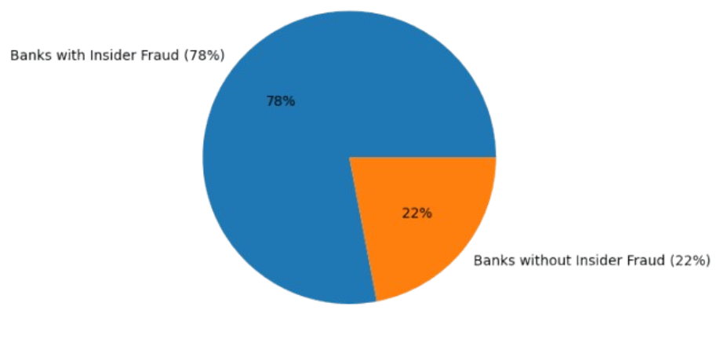

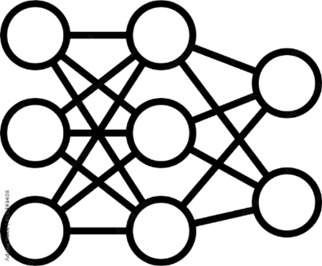
SurakshaAI
THE CHALLENGE
THE SOLUTION
INNOVATION
Current Problem Landscape:
Problem: 78% of banks faced insider fraud in last 12 months. Detection takes 287 days.
Cost: $15.38M per incident.
AI-powered system that monitors privileged users across banking systems and detects fraud in real-time.
Real-time monitoring of core banking, treasury, loan systems
Behavioral baselining per user
Anomaly detection with risk scores
Alerts with contextual explanations
Dashboard for fraud investigation team
Uniqueness:
First solution combining Graph Neural Networks (detects multi-user collusion) + LLM Assistant (natural language investigation queries)

Slide 4

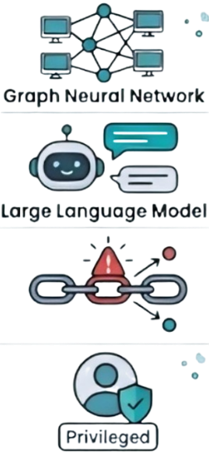

OUTLINE OF UNIQUE & INNOVAITVE SOLUTION
Existing Solutions | Our Solution
Individual user monitoring | GNN Collusion Detection – catches fraud rings
Manual log analysis | LLM Assistant – natural language queries
Static risk scores | Risk Propagation – connected users auto-updated
Generic approach | Privileged User Focus – specialized models
Innovation: No commercial platform offers GNN-based collusion detection + LLM investigation in one system.

Slide 5
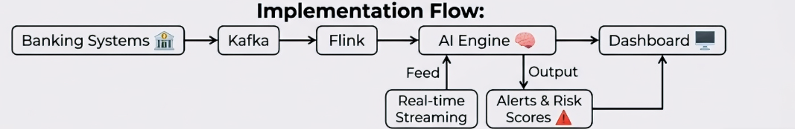
TECHNICAL APPROACH
Layer | Technology
Data Ingestion | Kafka
Stream Processing | Apache Flink
ML Models | Python, PyTorch, PyTorch Geometric, scikit-learn
LLM | Gemini 2.5 Flash API
Storage | Elasticsearch, PostgreSQL
Dashboard | React, WebSocket
Data Source: CMU CERT Dataset (135M events, 4,000 users, validated threat scenarios)

Slide 6
FEASIBILITY & VIABILITY
Aspect | Assessment
Data | CMU CERT dataset provides realistic banking logs
Technology | All tools are production-proven (Kafka, PyTorch, Elasticsearch)
Models | Autoencoders reduce false positives by 59% (proven in academic papers)
Key Challenges & Mitigations:
Challenge | Mitigation
Real-world log formats | Adapter pattern for easy integration
GNN complexity | Start with simpler graph algorithms, then scale
False positives | Human-in-the-loop feedback + continuous retraining

Slide 7
IMPACT & BENEFITS
👥 Audience
💰 Economic
CISO: Real-time visibility into threats
Investigator: Investigation time reduced from 4hrs to 30min
Compliance Officer: Provides audit-ready trails for regulations
Fraud Loss: 80% reduction, from $15.38M to $3M
Investigation Time: Decreased by 87%
ROI: Achieved 7.6x within the first year
🤝 Social
🌱 Environment
Customer Trust: Increased by 40%
Employee Privacy: Ensured through role-based monitoring
Investigator Well-being: Improved with 60% fewer false alerts
Energy Efficiency: Serverless architecture scales on demand, reducing consumption
Paperless: 100% digital case management eliminates paper waste
Carbon Footprint: Reduced through optimized processes and remote team support
“80% fraud reduction, 87% faster investigations, 7.6x ROI—while protecting customer trust, privacy, and the environment.”

Slide 8
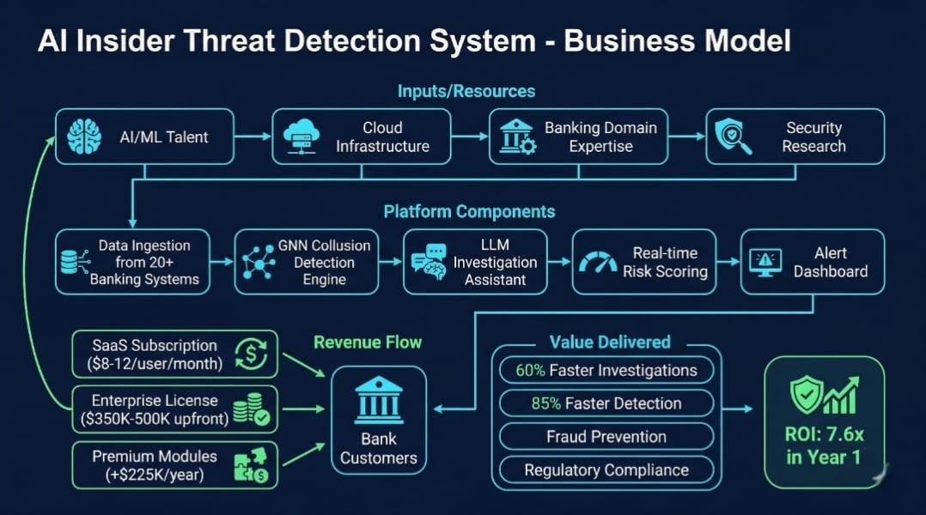
BUSINESS MODEL
Value Proposition
GNN collusion detection
LLM investigation assistant
Real-time monitoring 60% reduction in false positives vs. rule-based systems
Explainable AI
🎯 Target Customers
Tier 1 Banks
Regional Banks
Fintech Companies
Decision Makers(CISO)

Slide 9
RESEARCH & REFERENCES
1] AI-Driven Insider Risk Management with Adaptive Scoring (2025)
This paper proposes an AI-based system that detects insider threats using behavioral analysis + dynamic risk scoring. It improves detection accuracy and reduces false positives using deep learning models and continuous feedback learning. (https://arxiv.org/abs/2505.03796)
2] Facade: Deep Contextual Anomaly Detection for Insider Threats (2024)
This system (used at Google) detects insider threats by analyzing user actions along with context (who, what, when, why). It achieves extremely low false positives using deep learning and contextual modeling. ( https://arxiv.org/abs/2505.03796)
3] Insider Threat Detection using GCN + Bi-LSTM (2025)
This paper combines Graph Neural Networks (GNN) with temporal models (LSTM) to detect insider threats. It models both relationships between users and time-based behavior patterns for highly accurate detection. ( https://ieeexplore.ieee.org/abstract/document/11311570/)
4] Explainable AI in Insider Financial Fraud Detection (2026)
This paper explains how Explainable AI (SHAP, LIME) improves fraud detection systems by making them transparent and trustworthy. It also compares deep learning models like LSTM, CNN, and GNN. (https://dl.acm.org/doi/full/10.1145/3794859)
Summary for the above Problem Statement :-
https://drive.google.com/file/d/13rmvefZ6oKO9IqYP-g06BAGWaLo4k-2q/view?usp=sharing

